Slide 1

Week 5 · NYC taxi data pipeline
Forecasting NYC
taxi demand
How many pickups will each
zone get in each hour?
Serhiy Dranko 09.10.2026

Slide 2

The data
23.5 M
1.15 M
6 months
cleaned trips:
yellow, green and FHV
with a pickup zone
zone-hour rows:
265 zones × 4,344 hours
Jan - Jun 2026
split by time
Train · Jan - Apr 2026
Val · May 2026
Test · June 2026
718,680 rows
197,160 rows
190,800 rows
*And hourly weather (Open-Meteo), NY holidays and the TLC zone lookup.

Slide 3

How the pipeline is built
Ingest
interim/*.parquet,
data_audit.csv
Download trips, zones, weather, holidays; validate schema, row counts,
weather coverage; plan joins
ingest, validate, audit
clean
12 rules (timestamps, duration, distance, fare, zone), each removal
logged; FHV rows without a zone dropped
cleaned_*.parquet, cleaning_report.csv
clean.py
features
Zone-hour aggregation, complete 265 × 4,344 grid, joins with row-
count asserts, lags, split by month
train, val,
test.parquet
features.py
train
Sklearn Pipeline per model, 3-fold TimeSeriesSplit, winner chosen
by validation MAE
demand_model.joblib,
metadata, MAE tables
train.py
test
Locked June month, scored once; refuses to run a second time
test_results.csv
evaluate.py

Slide 4
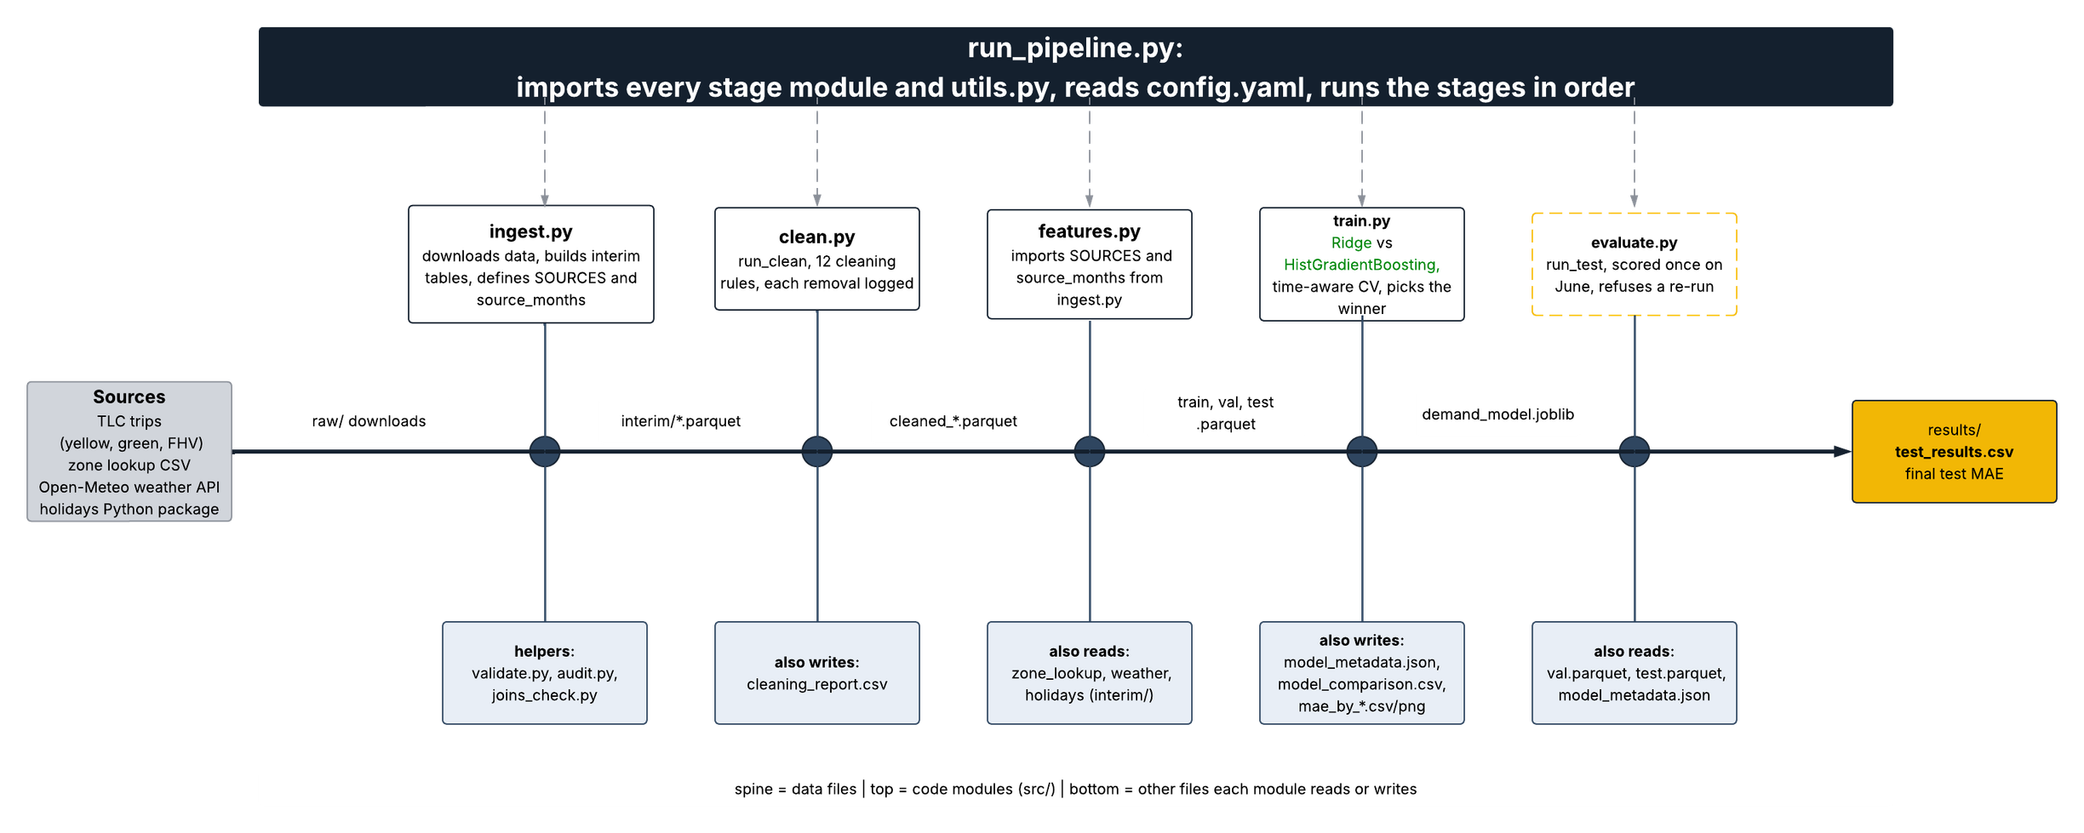
How the files connect

Slide 5

Data and feature decisions
Complete zone-hour grid
Weather joined after aggregationc
A plain groupby drops hours with zero trips and overstates demand, so every zone × hour exists, with 0 where nothing happened.
A per-trip join repeats hourly values millions of times. Every join asserts that the row count did not change.
Lags use only the past
Split by month, not randomly
lag_1, lag_24, lag_168 and a rolling mean shifted by one hour. No leakage; the first week is dropped (44,520 rows).
Train Jan -Apr, validate May, test June. A random split would leak future demand into training.
Quality checks: 12 cleaning rules; 84–92% of FHV rows have no pickup zone and are dropped.

Slide 6
Why gradient boosting
Model
CV MAE
Val MAE
More stable: fold-to-fold std 0.14 versus 0.33.
Baseline
5.10
Fits the shape of the data: trees capture hour × zone effects that a linear model needs hand-made interactions for.
Ridge
4.21 ± 0.33
4.02
Honest selection: chosen on validation;
the test month was never used for any decision.
Hist Gradient Boosting
3.61 ± 0.14
3.66

Slide 7
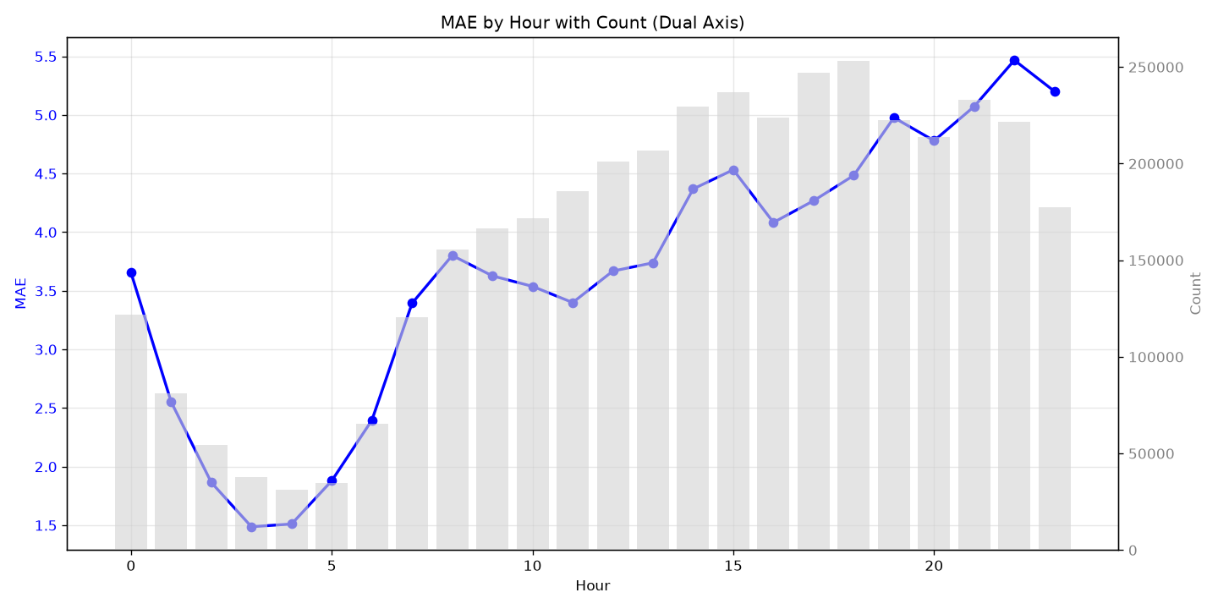
Where it fails: by hour
Best at night: MAE 1.5 at 03:00.
Worst in the evening: 5.5 at 22:00.
Error follows volume:
grey bars are trips per hour, and they rise with MAE.
Likely cause: busier hours are larger and noisier, and MAE is absolute.

Slide 8
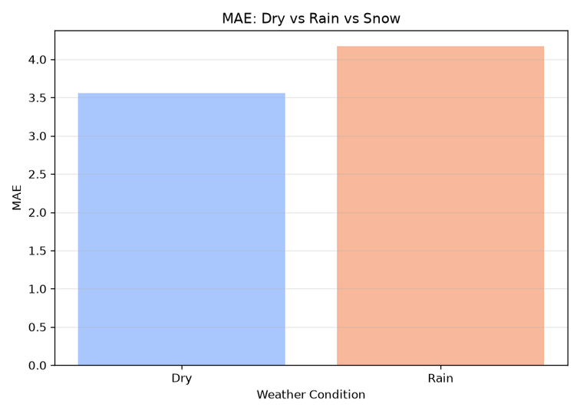
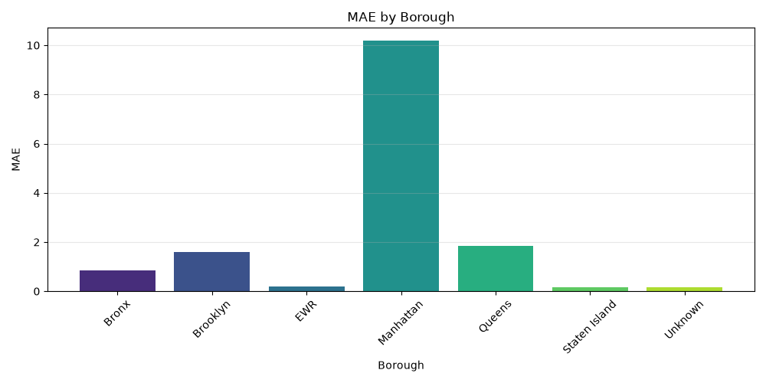
Where it fails: borough and weather
Rain 4.2 VS Dry 3.6.
*No snow bar: validation has no snowfall.
Manhattan MAE more than 10, every other borough under 2. Absolute MAE tracks demand volume.

Slide 9
Limits and next steps
Limits
What next
  Six months of data, one test month
  No snow in validation, so snow error is unknown
  Observed weather, one point for the city; real use needs forecasts
  Most FHV trips lack a pickup zone
  Reuse: validation, logging, train and evaluate structure
  Change: config, cleaning rules, features and target
  Next: more months, the holiday flag, weather forecasts

Slide 10
Thank you for your attention!
I will be happy to answer your questions.

